Slide 1

Introduction to
MongoDB
By- ANKESH GAUTAM

Slide 2

AGENDA
Problems in RDBMS
What is MongoDB?
Why use MongoDB?
Comparing Mongo terminologies with SQL
Understanding Document Model
Setup – Cloud/Local
CRUD Operations and Cursor Methods
Drawbacks

Slide 3
2 Major Problems in RDBMS

Slide 4

1. SCALABILITY
Difficult to scale millions of millions of data.
Data stored in multiple tables (relationship) it is difficult to scale.
Vertical Scaling

Slide 5

2. FLEXIBILITY
Fixed data structure therefore not easy to make modifications to data structure
You need to spend hours and hours on designing the database before development
In Agile projects database requires constant restructuring

Slide 6
Solution?

Slide 7
What is MongoDB ?
A Scalable, High-Performance, Open-source, Document-oriented database.
Schema-Less Database.
Stores data in BSON format.

Slide 8
Why use MongoDB?
Data Design Flexibility.
Auto Sharding for Easy Scalability.
Replication and Failover for High Availability.
Full Index Support for High Performance.
Rich Document based queries for Easy readability.
Leading NoSQL database.

Slide 9
Let’s Dive in !

Slide 10
When I say
Think
Database
Database
Made up of Multiple Collections.
Created on-the-fly when referenced for the first time.

Slide 11
When I say
Think
Collection
Table
Schema-less, and contains Documents.
Indexable by one/more keys.
Created on-the-fly when referenced for the first time.

Slide 12
When I say
Think
Document
Record/Row
Stored in a Collection.
Can have _id key – works like Primary keys in MySQL.
Document storage in BSON (Binary form of JSON).

Slide 13
Understanding the Document Model
{ ‘_id’:‘3432’,
‘title’: ‘Introduction to MongoDB’, ‘body’: ‘MongoDB is an open sources.. ‘, ‘timestamp’: Date(’01-04-12’),
‘tags’: [‘MongoDB’, ‘NoSQL’],
‘comments’: [{‘author’: DBRef(‘User’, 4),
‘date’: Date(’02-04-12’),
‘text’: ‘Did you see.. ‘, ‘upvotes’: 7, … ]
}

Slide 14
SETUP
CLOUD
LOCAL

Slide 15

CRUD Operations

Slide 16
Create Operations
db.collection specifies the collection or the ‘table’ to store the document
db.collection_name.insert( <document> )
Omit the _id field to have MongoDB generate a unique key
Example db.parts.insert( { type: “screwdriver”, quantity: 15 } )
db.parts.insert({_id: 10, type: “hammer”, quantity: 1 })
db.collection_name.save( <document> )
Updates an existing record or creates a new record
db.collection_name.insertMany( [<documents>])
Will insert one or more records in a collection

Slide 17
Read Operations
db.collection.find( <query>, <projection>(Optional) ).cursor
Provides all matching documents satisfying the <query>
Example: db.parts.find({parts: “hammer”})
cursor methods are use to modify the data received after find()
db.collection.findOne( <query>, <projection>(Optional) )
Provides first matching document satisfying the <query>
Example: db.parts.findOne({parts: “hammer”})

Slide 18
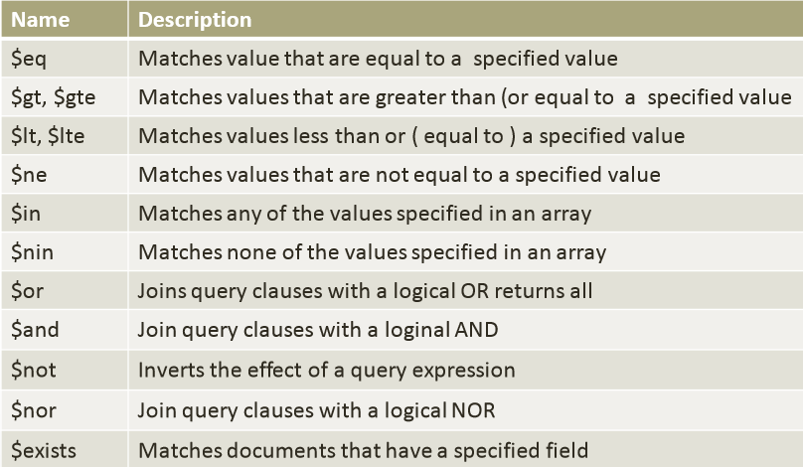
Query Operators

Slide 19
Projection
Selecting only the necessary data rather than selecting whole data of the document.
_id field is always displayed by default, if you don't want this field, then you need to set it as 0.

Slide 20
Cursor Methods
Some of the cursor methods are:
Skip()
Limit()
Sort()
Pretty()
Count(), etc.
Lets Try

Slide 21
Update Operations
db.collection_name.update( <query>, <update>, <options>)
Will update 1 or more records in a collection satisfying query
Some Update Operators $set, $rename, etc.
Options like multi, upsert, etc.
db.collection.updateOne(<query>, <update>, <options>)
db.collection.updateMany(<query>, <update>, <options>)

Slide 22
Delete Operations
db.collection_name.remove(<query>, <justone>(Optional))
Provides all matching documents satisfying the <query>
Delete all records from a collection or matching a criterion
<justone> - specifies to delete only 1 record matching the criterion
Example: db.parts.remove( { type: “hammer” } )
db.parts.remove({}) – delete all documents in the parts collections

Slide 23
Drawbacks of MongoDB
No Joins Nor Transactions
Problems requiring SQL.
Maturity
Not good for Highly Transactional Applications.

Slide 24
Questions?
Next Steps: https://mongodb.org
Thank You ☺

